Slide 1
Evidence Based HIV Interventions in Faith Based Organizations: Implications for implementation Science
Jennifer M. Stewart PhD, RN
Johns Hopkins University
School of Nursing

Slide 2
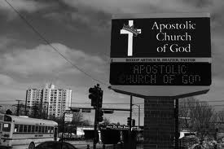
Notes:
The african american church historically important
86% report affiliation large amount of people available to target
Often located in communities at greatest risk

Slide 3
Methods: Adaptation
Implementation Strategies
Methods: Multilevel
Notes:
Essential to use multilevel and multimethod approaches to implementation
Essential to consider the role of adaptation to support buy-in and sustainability
Talk a little about strategies that can be employed to support implementation

Slide 4
Multilevel methods

Slide 5
Methods
Individual
Interpersonal
Organizational
Social
Perceived risk
Attitudes/beliefs
Self-efficacy
Norms
Popular opinion leaders
Diffusion
Social support
Relationship dynamics
Capacity
Culture/Climate
Stigma
Readiness
Social capital
Neighborhood/
Environment
Access to care
Health disparities
Notes:
A basic assessment of what barriers and facilitators would promote and impede implementation revealed a multilevel model which addressed individual, interpersonal, organizational and social factors.
In addition at the organizational level it was important to consider the church hierarchy which is unique in churches in comparison to other community based organizations in that way there are some nuances to be considered in implementation with a nested multilevel hierarchy within the organizational level as well

Slide 6
Methods
Individual
Interpersonal
Organizational
Social
Intervention Characteristics
Ease of Use
Adaptability
Perceived Need
Appropriateness
Notes:
To further complicate or make things interesting implementing HIV interventions into faith settings makes it necessary to also consider the intervention characteristics. HIV interventions address topics that are often considered taboo or topics that churches have strong religious views about: condom usage, abstinence, homosexuality, and drug use for example

Slide 7
Adaptation
Notes:
Subsequently one of our first trials looked at adaptation of EBIs to facilitate implementation

Slide 8
Adaptation of Evidence Based HIV Interventions
Notes:
We first addressed the young adult African American women’s population. It’s important to take a contextualized approach to sexual health for young black women in the case of any intervention. As I mentioned before religion and spirituality is an important part of that context for African Americans especially women so we sought to adapt an existing EBI, Sister to Sister to be appropriate for women in faith settings.

Slide 9
Organizational factors
Intervention factors
Individual factors
Notes:
Numerous evidence-based interventions (EBIs) for HIV prevention with proven efficacy have been developed for African American women
African American churches are receptive to HIV risk reduction interventions, which are designed or adapted to be in alignment with their church’s culture, and their unique religious needs
Planned adaptation of interventions has also been presented as a viable approach to implementation of evidence based interventions
We chose to adapt the Sister to Sister intervention based off of our understanding of the impact of organizational factors, intervention charactersistic related factors and individual level factors for our target population

Slide 10
Implementation Strategies
Notes:
Planned adaptation became a strategy to support implementation this and a popular opinion leader network strategy are the two strategies I will address briefly in the next few slides

Slide 11
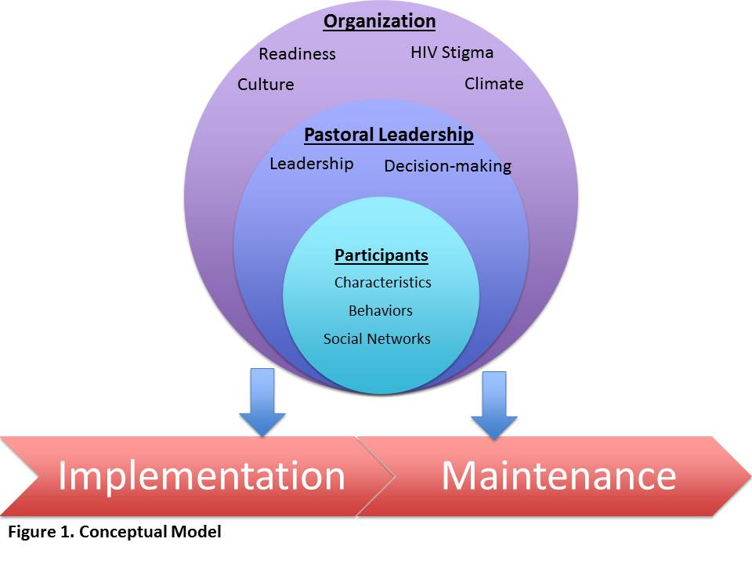
Design and methods
Hybrid type 2 effectiveness-implementation mixed methods design
Mixed Methods
Church leadership interviews
Participant focus groups
Surveys
Implementation
Behavioral
Implementation
Context
Notes:
For our adaptation strategy we elected to take a hybrid type 2 effectiveness implementation mixed methods design approach. That’s a mouthful but I’ll summarize what that is in just a bit
Again we took a multilevel approach but just looking at the organizational, leadership and individual participant level. We chose to look at implementation and along with that acceptability and maintenance
As a hybrid type 2 trial we were looking at the implementation outcomes of acceptability and maintenance. Implementation science outcomes are different that your typical behavioral effectiveness outcomes and can include acceptability, maintenance, fidelity among others. We also ran an effectiveness trial concurrently. Making this a hybrid trial looking at both behavioral and implementation outcomes for two interventions the original sister to sister EBI and the adapted form of Sister to sister which we named Covher
As is typical in many implementation science studies we took at mixed methods approach collecting both quantitative and qualitative data to get a more fulsome view of the entire implementation process.

Slide 12
Results
Table 4. Sexual behavior in the last 3 months by intervention group at pre and post test (N=91).
 | Intervention Group
Variable of Interest | Original |  |  |  | Adapted
Behavior Status, n(%) | Pre | Post | n | p | Pre | Post | n | p
Sex in last 3 months, n(%) | 20 (79.4) | 26 (76.5) | 34 | 1.000 | 17 (90.0) | 28 (93.3) | 30 | 1.000
Always condom use, n(%) | 2 (8.3) | 4 (16.7) | 24 | 0.687 | 6 (23.1) | 8 (30.8) | 26 | 0.625
Sexual risk, median
Days of abstinence | 6 | 10 | 18 | 0.043 | 10 | 13.5 | 18 | 0.035
Days without condom use | 10 | 3.5 | 18 | 0.078 | 6.5 | 3.5 | 20 | 0.035
Number of sex partners | 1 | 1 | 24 | 0.317 | 1 | 1 | 26 | 0.317
Proportion unprotected sex days | 1 | 1 | 23 | 0.145 | 1 | 1 | 24 | 0.596
Within groups analyses: McNemar test for binary outcomes and Wilcoxon matched-pair signed-rank for continuous outcomes.
Between groups analyses: Binary logistic regression and ANCOVA for binary and continuous outcomes respectively, with baseline value and intervention group as predictors.
Notes:
We were surprised by the behavioral outcomes. The original Sister to Sister intervention increased condom use but this outcome did not hold up in our implementation trial. Both the original intervention and our adapted intervention increased abstinence from sex and the only the adapted intervention increased condom use.

Slide 13
Results
 | Church 1 (O) (n=26) | Church 2 (n=31) | Church 3(O) (n=21) | Church 4 (n=19)
Characteristic (%)
Acceptability
Yes | 19 (73.1) | 26 (83.9) | 18 (85.7) | 17 (89.5)
No | 7 (26.9) | 5 (16.1) | 1 (4.8) | 2 (10.5)
Maintenance
Yes | 22 (88.5) | 28 (90.3) | 17 (90.5) | 18 (94.7)
No | 4 (11.5) | 3 (9.7) | 4 (9.5) | 1 (5.3)
Notes:
The acceptability and desire to maintain the intervention was slightly higher in the churches that had the adapted intervention and the qualitative data indicated that they were more enthusiastic about the adapted intervention. This was not necessarily a surprise as we worked with a different set of churches in the adaptation process prior to implementing the adapted intervention in this new set of churches where as the original sister to sister intervention was deliverd “as is”
Mention significant correlation
Behavioral Intervention Rating Scale (BIRS) will measure acceptability. We will use the 15 items from the acceptability scale which has an alpha of 0.97.30
Acceptable for the problem, appropriate for the population
Acceptability
“HIV stigma and homosexuality attitudes. That’s going to be the biggest barrier to get over to make this work.”
Maintenance
“I could see getting some of the women in the church to carry this program on. Some of them have healthcare backgrounds.
“I enjoyed the session. Its got to be something people like in order for it to keep going.”

Slide 14
Conclusions
Acceptability of evidence based HIV interventions in faith settings may be impacted by a variety of factors including, adaptability of the intervention, and levels of HIV and homosexuality related stigma
Maintenance of interventions, on the other hand, may be impacted by the culture and climate of the organization, resources and capacity of the faith based organization, and availability of intervention champions.
Final analyses showed short term efficacy in abstinence and trends towards increased condom use.
Future studies can look into other factors that impact acceptability over time and conduct longitudinal studies assessing actual maintenance versus intentions to maintain evidence based interventions.
*Stewart, J.M. (2014). Implementation of evidence-based HIV interventions for young adult African American women in church settings. Journal of Obstetrics Gynecologic, and Neonatal Nursing, 43 (5), 655-663.
Implementation of an Evidence Based HIV Intervention for African American Women. Academy Health/Aetna Foundation. Role: PI.
Adaptation of an Evidence Based Sexual Risk Taking Intervention for Young Adult African American Women in Church Settings, PI: C. Hendricks Brown (P30-DA027828), Role: Pilot PI,
Notes:
Also from some of the qualitative data we found that acceptability was impacted by the adaptability and levels of HIV and homosexuality related stigma while maintenance was more relate to the culture of the church, resources and availability of intervention champions
Mentioned before that the behavioral effectiveness outcomes were a bit of a surprise and warrant further investigation about how well evidence based intervention outcomes ”hold up” in faith settings

Slide 15
Ethnographic assessment
POL buy-in
Identify intervention
Adaptation
Sustainability planning
QI and evaluation
Pretesting
Notes:
The next strategy we attempted to use in implementation was to see if our findings as it pertained to needing intervention champions and buy-in could be leveraged to promote implementation. We elected to use just Sister to Sister to see if we could tease out what happened with our behavioral outcomes and instead of our team delivering the intervention we identified church popular opinion leaders and trained them as facilitators
We maintained what became our basic method and approach to implementation of HIV EBIs in faith settings beginning with an ethnographic assessment of culture, climate and readiness. We added in identifying and training popular opinion leaders, identifying and presenting the intervention’s characteristics to leadership, very minor adaptations in this case facilitators taken from the church, sustainability planning, and what in this case became testing and then evaluation of the intervention

Slide 16
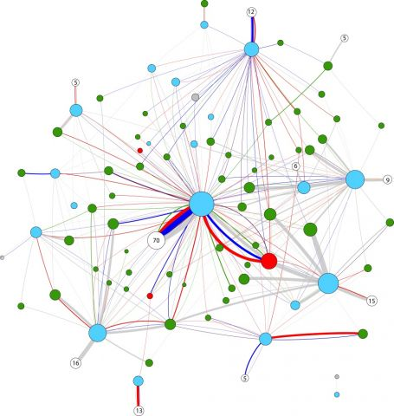
Notes:
We used a Network Based Enhanced Facilitator Training For implementation to see if this would impact the implemementation process and also to see how the flow of information, norms and behaviors occurred in the faith settings.
The African American church is a complex, hierarchical network (i.e. pastors, church leaders, and congregants).
The context and interactions between and among these levels of influence underlie implementation success.
There is also a great degree of diversity among African American churches in regards to patterns of communication and interaction among formal and informal leaders and sub networks.
This may promote or impede the organizational change needed to promote implementation.¹⁸⁻²⁰ In order to understand and promote acceptability and maintenance of EBIs to prevent HIV, the multiple constituencies, organizational context, and networks must be examined via a multi-level systems approach.^{16,18,21}
Purpose: (1) test the effect of the addition of SHIELD a social network intervention as an implementation strategy to promote acceptability and maintenance of Sister to Sister,²³ an HIV EBI, into a church setting for African American women between the ages of 18-44 and (2) examine the role of organizational variables on implementation.
Implement Sister to Sister into 4 African American churches to:
estimate the effect on the behavioral outcomes of consistent condom use, number of unprotected sexual intercourse acts, and frequency of sex among African American women aged 18-44 at baseline and 3 months;
examine the impact of the addition of a social network intervention on the implementation outcomes of acceptability and maintenance at baseline and 3 months.
Examine the impact of the churches’ organizational level variables (culture, climate, HIV related stigma, and readiness) on implementation via a mixed methods assessment of pastors, church leaders, and congregants;
examine which organizational, network, and individual level factors predict changes in norms related to acceptability and maintenance.

Slide 17
Fidelity and effectiveness
Adaptation and buy-in
Reach and sustainability
Notes:
This trial is a work in progress as we have just completed collecting follow up data but I can briefly highlight the challenges (because there were mostly challenges) and how they might provide opportunities for the future of this work. First in training church members as facilitators we noted that complete fidelity to the intervention was not always maintained. Our assumption is that this will negatively impact the outcomes but we were surprised in our previous trial that complete fidelity did not necessarily ensure the same positive outcomes in the originally efficacy trial of Sister to sister. There is a possibility in the current study to see how fidelity and effectiveness are related
Also adaptations that don’t change much of the content but instead change the mode of delivery can be just as effective in ensuring buy in and investment. Having gone through the process of both we saw that the level of buy in and sustainability were equivalent
Lastly while our follow up rates were excellent in the trial in which our team delivered the intervention this trial in which the church POLs delivered the intervention was kinda terrible. With our network data we will be able to see if the intervention content diffused at all into the church itself but we can’t be completely sure of the reach of the intervention in this case but it may be something to explore more going forward.

Slide 18
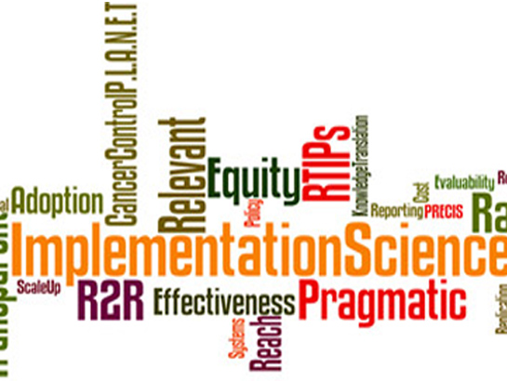
Notes:
Much to still study, much to still learn in this area.

Slide 19
Acknowledgements
Funders
NIMH/REIDS/K23 NIDA/CePIM
NIAID/HPTN/Johns Hopkins CFAR
NINR/UPenn Center for Health Equity
Participants
Pastors
Church leadership
Congregants
Collaborators
Carl Latkin
David Celentano
Patricia Davidson
Sten Vermund
Ada Adimora
Hendricks Brown
Gina Wingood
Barbara Guthrie
Loretta Sweet Jemmott
Marilyn Sommers
Barbara Dancy

Slide 20
Thank you
Jennifer Stewart, PhD, RN
jstewa44@jhu.edu

